Slide 1
Module 4 final project
Zhiqiang Sun

Slide 2
Overview
For this project, we trained a pretrained cnn model to predict the Classification of the x-ray images.
Business understanding
The medical dataset comes from Kermany et al. contains a set of x-ray images of pediatric patients. The images will show whether the patients have pneumonia or not. our task is to build a model that can classify whether a given patient has pneumonia, given a chest x-ray image. Since this is an Image Classification problem, we are going to solve it with Deep Learning.

Slide 3
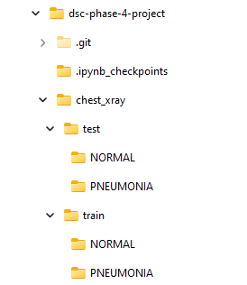
In train folder, there are normal folder which contains 1349 images and PNEUMONIA folder which contains 3884 images. In test folder, there are normal folder which contains 235 images and PNEUMONIA folder which contains 390 images. The images in each folder is too large for the modeling since our local computer is not very powerful for the multiple testing. We need to down sampling the dataset first to find the optimal model and parameter first. Then using the full dataset to train and test our model. Based on our earlier experience, we will use 20% of the total dataset to modeling our model. We also need to make 10% of the training data to validation dataset.

Slide 4
Plan
Downscaling the data set by randomly choosing 20% of the original training and testing images to the new data_org_subset folder. Make a new folder of validation and random select 5% of the images from training folder.
Define the train generator, validation generator and test generator.
Build the deep learning model base on the pretrained CNN (VGG19) by adding a few fully connected layers. Train the model with selected images.
Retrain the model with full training data.
Evaluate the model with the test images.

Slide 5
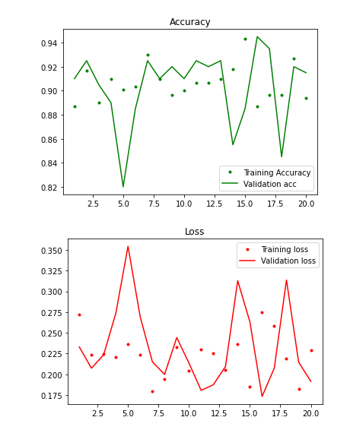
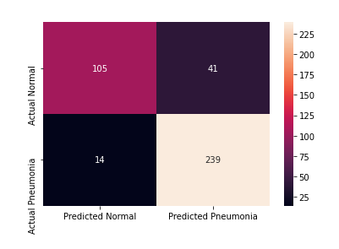
acc: 0.9750

Slide 6
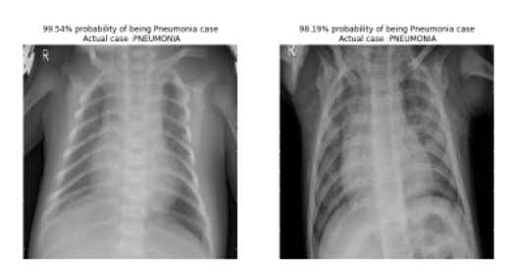

Slide 7
Conclusion
Based on 20% of the whole dataset, we created a CNN model based on a pretrained model (VGG19) which can classify X-ray images as a Pneumonia case or a Normal case. The model was then retrained with whole dataset and tested with the separated test images. The accuracy of the prediction is around 95%.

Slide 8
Thanks!
Zhiqiang Sun
sunzhiqiang04@gmail.com

